Slide 1
Grover on Sparkle
Yujin Yang, Kyoungbae Jang, Hyunji Kim, Gyeongju Song, and Hwajeong Seo
Hansung University
yujin.yang34@gmail.com
Notes:
Hello everyone, Thank you for being here today. I’m Yujin Yang from Hansung University.
The topic of my presentation is ‘Grover on Sparkle.’
In this presentation, I’m going to talk about a quantum implementation for authenticated ciphers of SPARKLE.

Slide 2
Introduction (Motivation, Contribution)
Background (Quantum Gates, Grover’s Algorithm for key search)
Body (Sparkle SCHWAEMM 128-128, Cost estimation)
Conclusion
Notes:
I will divide my presentation into 4 parts.
First, let me talk about Introduction. This consists of motivation and contribution.
Aan then, we will move on to Background Quantum gates, and Grover’s algorithm for key search.
Next, I will explain Body SPARKLE SCHWAEMM 128-128 and cost estimation..
Lastly, we're going to look at Conclusion.

Slide 3
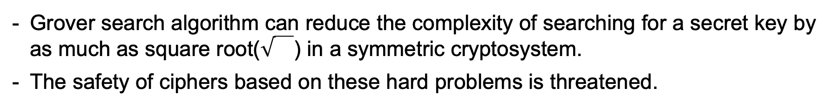
Motivation (Introduction)
Quantum computers develop and Grover search algorithm appeared
Grover search algorithm can reduce the complexity of searching for a secret key by as much as square root() in a symmetric cryptosystem.
The safety of ciphers based on these hard problems is threatened.
Studies are underway to analyze threats to the Grover algorithm for symmetric cryptosystem
The field of research has expanded to lightweight ciphers in recent years.
KNOT is the only quantum implementation of AEAD
Implementation of AEAD of SPARKLE(NIST LWC final candidate) as a quantum circuit
Notes:
This part is Motivation of Introduction.
At first, Quantum computers develop and Grover search algorithm appeared.
Grover search algorithm can reduce the complexity of searching for a secret key by as much as square root in a symmetric cryptosystem.
As a result, The safety of ciphers based on these hard problems is threatened.
Studies are underway to analyze threats to the Grover algorithm for symmetric cryptosystem.
In recent years, the field of research has expanded to lightweight ciphers.
Among them, KNOT is the only quantum implementation of AEAD.
So, we implemented AEAD of SPARKLE(NIST LWC final candidate) as a quantum circuit.

Slide 4
Contribution (Introduction)
Reported first quantum implementation of all parameters of SCHWAEMM
SCHWAEMM is AEAD of lightweight block cipher SPARKLE
Optimized the quantum circuit by reducing the depth and the number of qubits
Used inverse operations and fake padding
Implemented quantum additions in parallel
Estimated the quantum resources & evaluated the post-quantum security level
Based on NIST security requirements
Applied Grover’s search algorithm to proposed quantum circuit
Notes:
These are our contributions.
First, We reported first quantum implementation of all parameters of SCHWAEMM which is AEAD of lightweight block cipher SPARKLE.
Second, We Optimized the quantum circuit by reducing the depth and the number of qubits.
By using inverse operations and fake padding, and Implementing quantum additions in parallel.
Lastly, we estimated the quantum resources and evaluated the post-quantum security level based on NIST security requirements by applying Grover’s search algorithm to proposed quantum circuit.

Slide 5
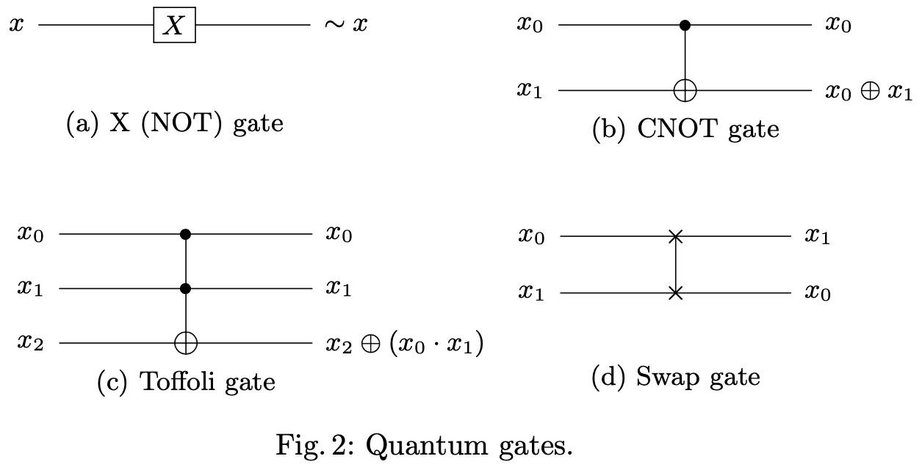
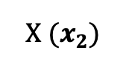
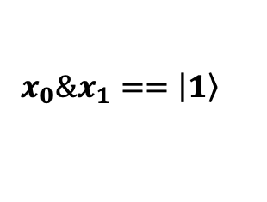
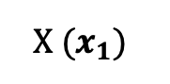
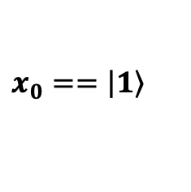
Quantum Gates (Background)
control qubit
$$x_{0}==\left|\left.1\right\rangle \right.$$
target qubit
$$X (x_{1})$$
$$x_{0}\&x_{1}==\left|\left.1\right\rangle \right.$$
$$X (x_{2})$$
Fig. 1: Quantum gates
Notes:
Let me explain the quantum gates which is background.
There are four representative quantum gates.
Look at 'a' in figure 1, X gate makes qubit x inversed like NOT gate in logical gates.
Next, CNOT gate stands for a controlled-not gate. Look at ‘b’, Green, blue each represents control qubit and target qubit. At CNOT Gate, if control qubit x0 is 1, target qubit x1 is inversed. The CNOT gate is able to generate entangled.
And, The CNOT gate is used many times our proposed quantum circuit.
‘c’ of figure 1 is Toffoli gate. Toffoli gate is stands for a controlled-controlled-not gate.
It can be seen as a CNOT gate with two control qubits. At Toffoli Gate, if both control qubits x0,x1 are 1, target qubit x2 is inversed.
Swap gate makes qubits x0,x1 exchange. value of x0 becomes value of x1 and value of x1 becomes value of x0.

Slide 6
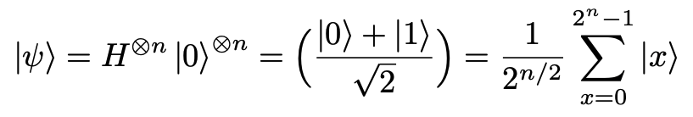
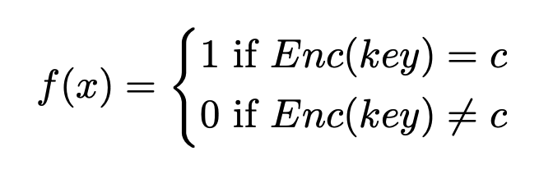
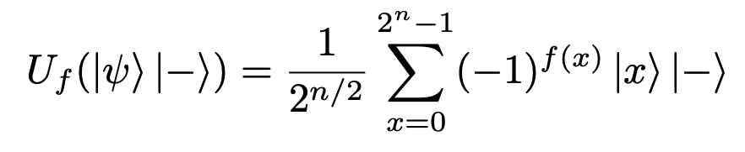
Grover’s Algorithm for key search (Background)
Through the use of Hadamard gates, n-qubit key has the same amplitude at all state of the qubits
✓
2. $f\left(x\right)=1$, sign of the solution key is changed to negative
00
01
10
11
superpositioned key
Oracle
known ciphertext
ciphertext
00
01
10
11
comparison
3. Amplify the amplitude of the negative sign state
00
01
10
11
Notes:
Grover’s Algorithm can reduce the complexity of searching for a secret key by as much as square root.
This is the process of grover's algorithm for key search.
At first, Through the use of Hadamard gates, n-qubit key has the same amplitude at all state of the qubits. Hadamard gates makes qubits suerpositioned state. So that, all state of the qubits has the same amplitude.
Look at the first step’s graph. When secret key is one zero, all four graph bars have the same value through the Hadamard gates.
Next, the oracle function f(x) consists of superpositioned key, ciphertext, and known ciphertext: blue key is the superpositioned key, green one is ciphertext using superpositioned key, red one c is known ciphertext.
f(x) is a function that compares ciphertext and known ciphertext.
If f(x) is one, that is, both values are same, sign of the solution key is changed to negative.
The graph of second’s step shows that secret key one zero’s graph bar becomes negative.
Third, Amplify the amplitude of the negative sign state.
This value is closely related to the value of f(x). When f(x) is 1, it is added, and when f(x) is 0, it is subtracted, so the amplitude of the secret key increases and the remaining values decrease.
Look at the graph, you can see that answer one, zero stands out.

Slide 7
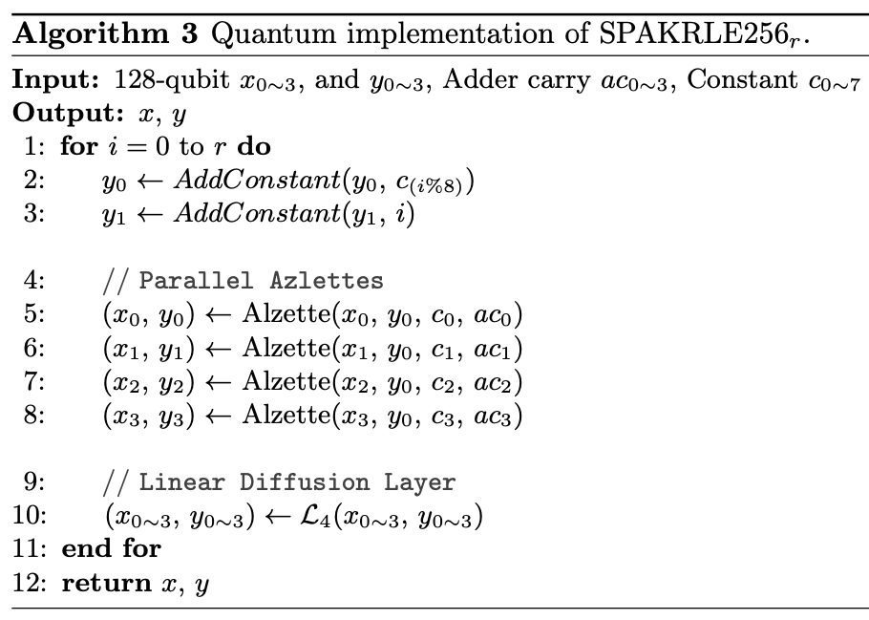
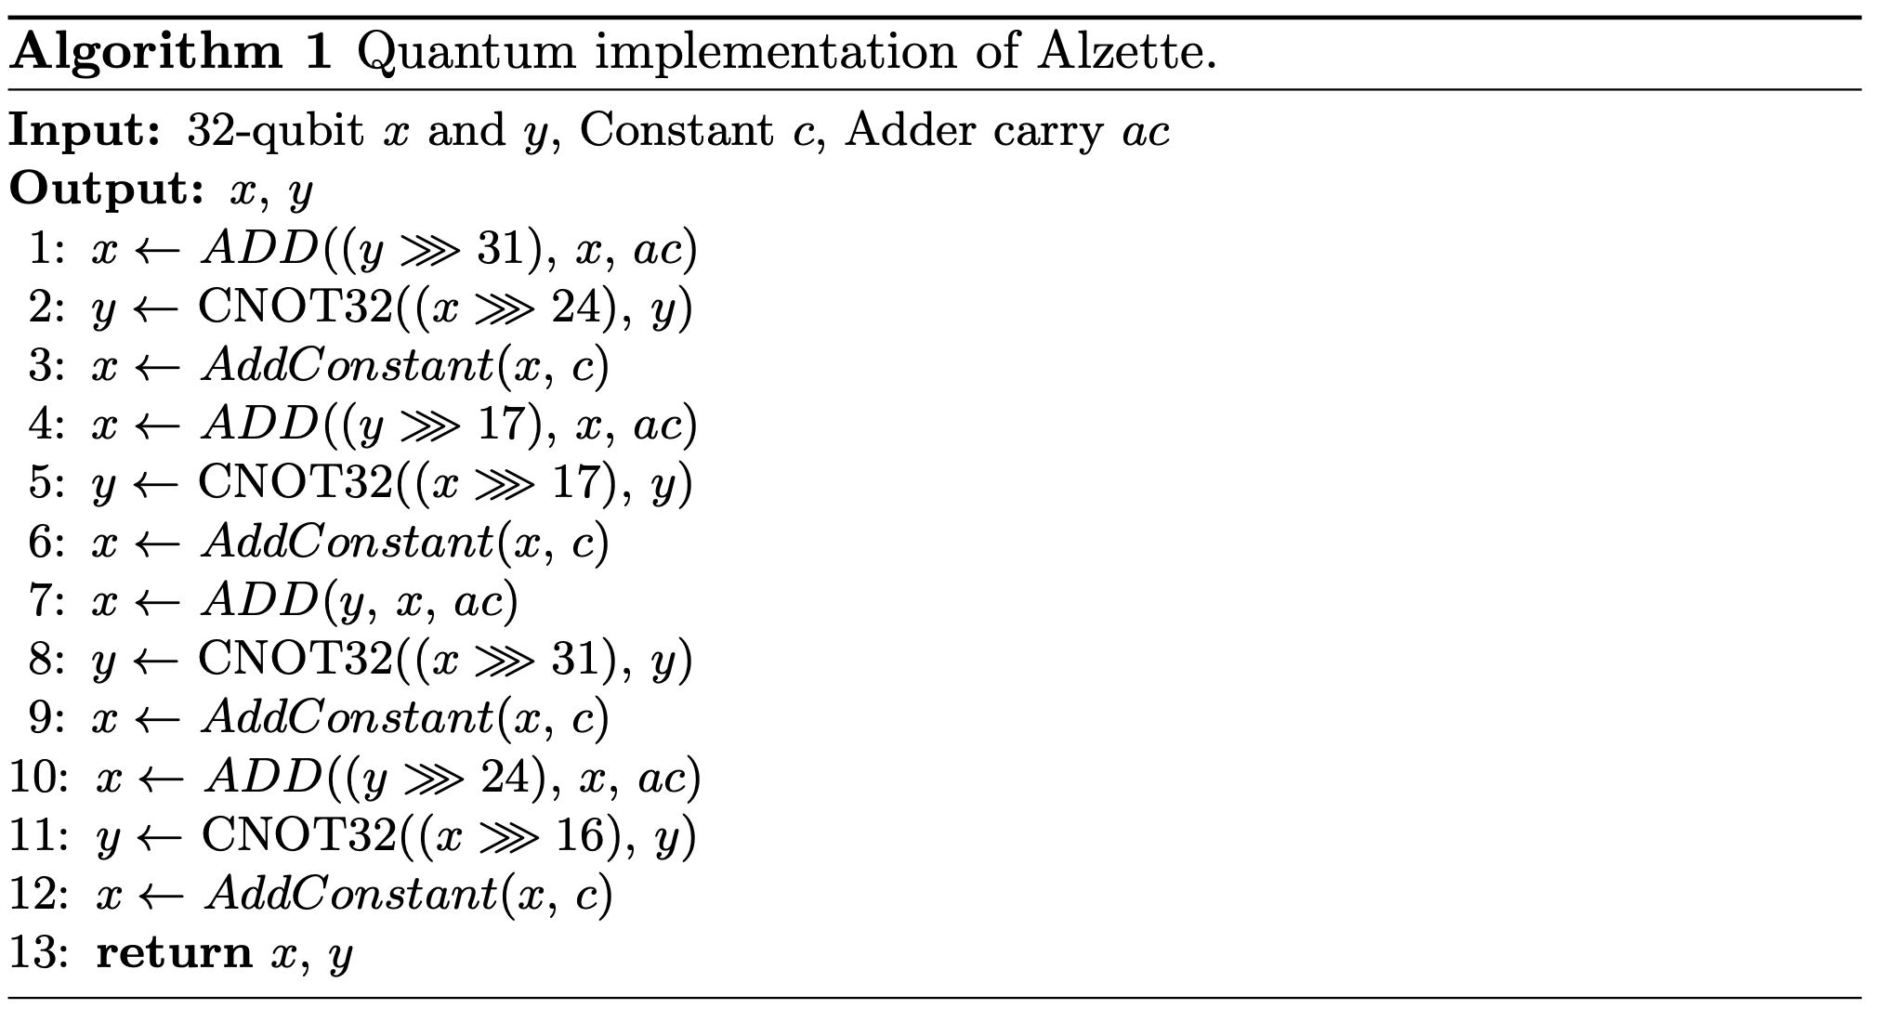
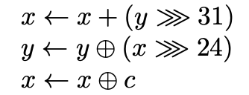
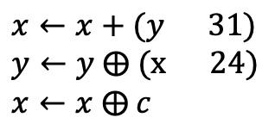
SPARKLE Permutation 1) Alzette
$$x←x+(y\text{ 31)}$$
$$y←y ⨁ (\text{x} \text{24}\text{)}$$
$$x←x ⨁ c$$
1-branch
Addition – CDKM ripple-carry adder
Rotation – logical Swap
XOR – CNOT gate
allocate 4 carry qubits
→ reduce depth
Notes:
Now let’s move on to SPARKLE permutation implementation.
First Alzette is a ARX-box. ARX stands for Addition, Rotation and XOR.
Right algorithm is the quantum implementation of Alzette.
CDKM ripple-carry adder that implemented ripple carry quantum adder, is used for Addition. Logical Swap is used for Rotation and XOR operation uses the CNOT gate.
Alzette consists of four branches. The black box is the example of single branch. The box represents the quantum circuit implementation of the equation on the right.
Left algorithm is the quantum implementation of Sparkle permutation. In Sparkle permutation, by allocating four ancilla qubits, we reduced depth.

Slide 8
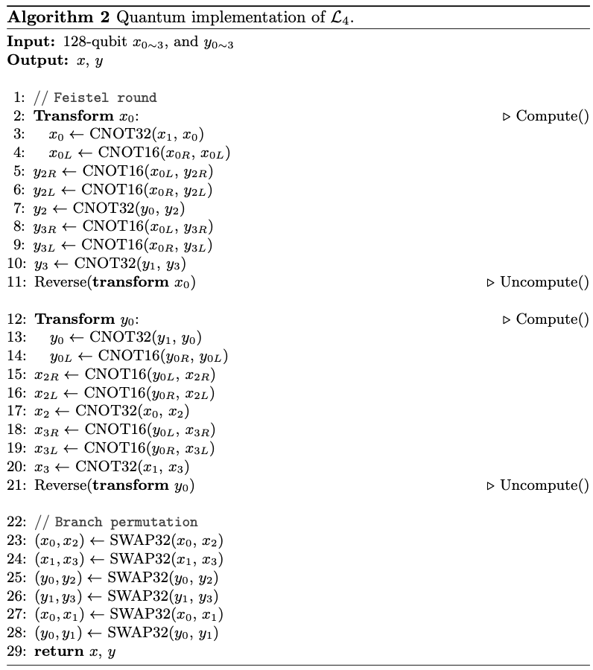
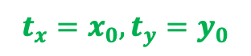
SPARKLE Permutation 2) Diffusion operator
©
calculate only necessary gates
→ save CNOT gates
Inverse operator
→ save 2 qubits
$$t_{x}=x_{0}, t_{y}=y_{0}$$
SWAP gate
Notes:
Second is Diffusion operator.
The orange part is where the diffusion operator is used in SPARKLE PERMUTATION.
Right algorithm is the quantum implementation of Diffusion operator.
txL means the left 16 qubits of tx, and CNOT Sixteen operator means operating by sixteen-bit.
We saved two qubits tx, ty by using the inverse operator / compute, uncompute of projectQ in order to use x0, y0 instead.
Things in the Compute scope can be reversed through the Uncompute function only for quantum operations.
And after 16-bit Left shift represented blue one, right 16 bits value is meaningless because it is 0.
Therefore, calculating only necessary gates saved the number of CNOT gates. (16개씩..)
Branch permutation uses SWAP gates.

Slide 9
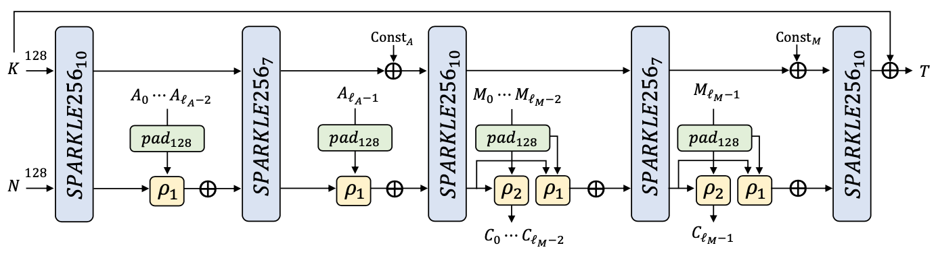
SCHWAEMM128-128
Fig. 2: Process of SCHWAEMM128-128
Padding Data
Processing of associated data
Finalization
State Initialization
Encrypting
Notes:
This is Process of SCHWAEMM 128-128, and it consists of 5 steps: Padding data, State initialization, processing of associated data, encrypting and finalization.
Let's look at the SCHWAEMM step-by-step implementation in the next page.

Slide 10
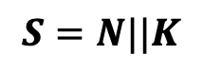
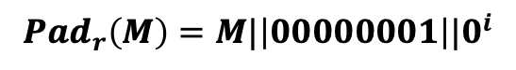
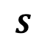
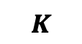
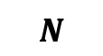
Padding Data & State Initialization
Padding Data
r: length of block ($i=−\left|M\right|−1 mod r)$
$${Pad}_{r}\left(M\right)=M|\left|00000001\right||0^{i}$$
- The padded Associated data/Message are only used in $ρ_{1}$ function
→ “fake padding”
- Don’t allocate padding qubits to compute only useful data in $ρ_{1}$
→ save 32 CNOT gates
State Initialization
Inner state $S$, Nonce $N$, Key $K$
- use CNOT gates
$$S=N||K$$
$$S$$
$$N$$
$$K$$
Notes:
First step is Padding data.
R is a length of block. The orange box is the calculation expression for the padding data step.
The padding data M is the concatenation of the 8-bit binary 1 and 0s as many as i numbers.
The padded Associated data/Message are only used in rho1 function. We call this “fake padding”.
In rho1, we didn't allocate padding qubits to compute only useful data, so saved 32 CNOT gates.
Second step is State Initialization. S is inner state, N is nonce, K is key.
S is a sequential connection of K and N by using CNOT gates.

Slide 11
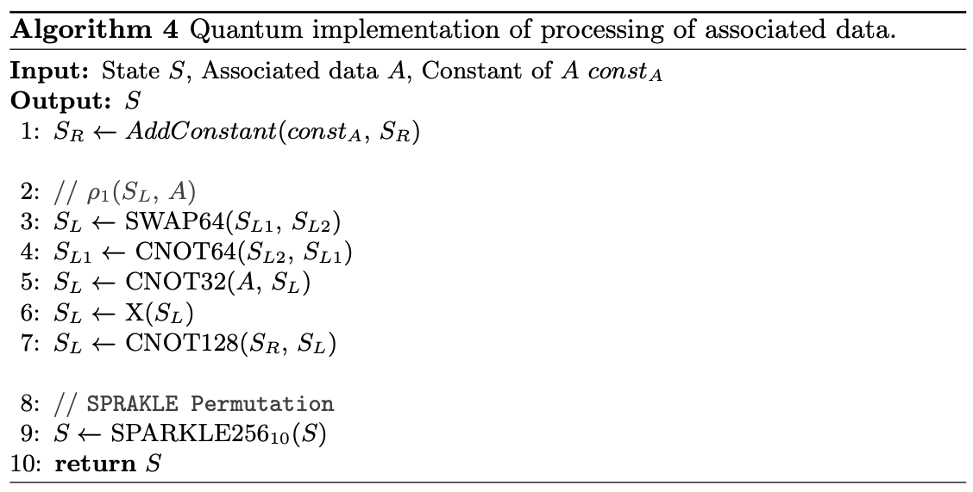
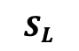
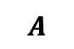
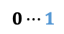
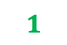
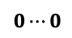
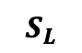
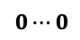
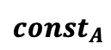
Processing of associated data
Processing of associated data
calculate only corresponding point (CNOT gates → X gate)
→ save gate resources & qubits
$$S_{L}$$
X
gate
calculate only corresponding point
1 qubit(padded data ‘1’): CNOT gates → X gate
→ save CNOT gates
$${const}_{A}$$
$$1$$
$$S_{L}$$
X
gate
CNOT gates
$$A$$
$$0⋯0$$
$$0⋯0$$
$$0⋯1$$
Notes:
Third step is Processing of associated data. At Add constant, constant A XORs to SR.
Because it is necessary to calculate only the part equal to 1 in the constant, an X gate was applied to the corresponding position of SL instead of declaring a constant qubit and performing SL and CNOT operations.
As a result, we saved gate resources and qubits
And then, as mentioned in the padding data phase, non-padded A is used when calculating rho1 function. Also, we used a X gate instead of single CNOT gate for padded data ‘1’.
As you can see in the blue figure, by calculating only corresponding point we saved the number of CNOT gates.

Slide 12
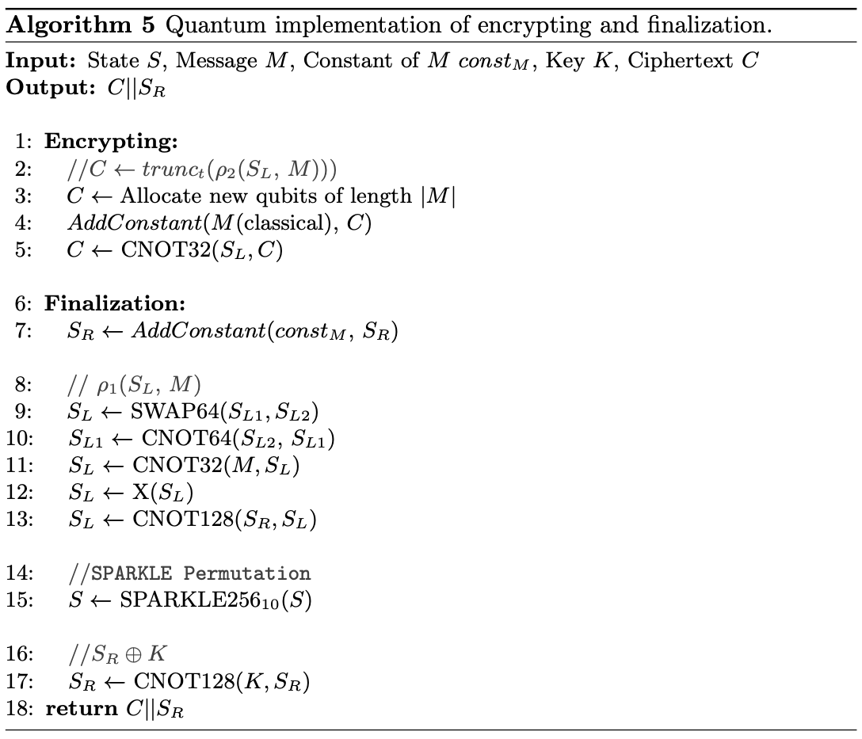
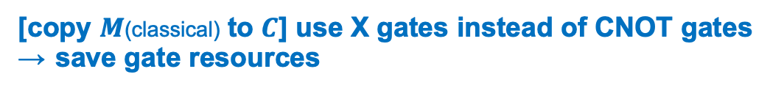
Encrypting & Finalization
Encrypting
[copy $M$(classical) to $C$] use X gates instead of CNOT gates
→ save gate resources
Finalization
calculate only corresponding point (CNOT gates → X gate)
→ save gate resources & qubits
Notes:
qubits and put Message M to Ciphertext C.
We used X gates instead of using CNOT gate between M and C, so we saved gate resources.
Final step is Finalization. AddConstant is also implemented using only X gates as before. Consequently, we saved gate resources and qubits.

Slide 13
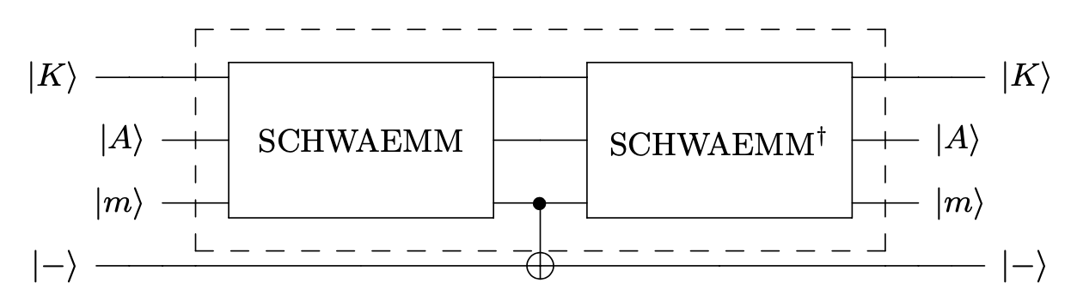
Cost Estimation for Grover Key Search
<Oracle operation>
Fig. 3: Grover’s oracle on SCHWAEMM
Encryption operation → Reverse operation
⇒ SCHWAEMM quantum circuit works X 2
Notes:
Oracle operation consists of Encryption operation and Reverse operation.
So, our proposed SCHWAEMM quantum circuit works twice as shown in Figure 3.

Slide 14
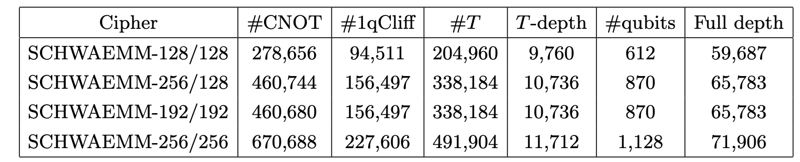
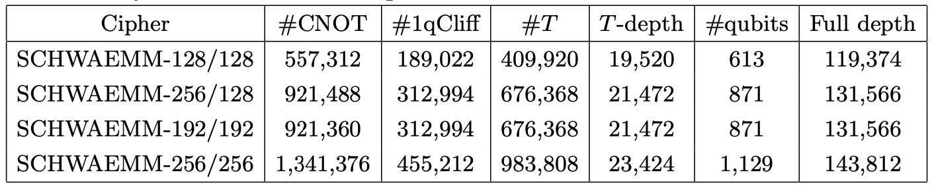
Cost Estimation for Grover Key Search
Table 1: Quantum resources required for SCHWAEMM quantum circuits in detail.
X 2
Table 2: Quantum resources required for Grover’s oracle on SCHWAEMM
Notes:
Let’s talk about quantum resources cost estimation.
Table 1 shows detailed quantum resources required for SCHWAEMM quantum circuits at the Clifford + T level.
Table 2 shows the quantum resources required for Grover’s oracle on SCHWAEMM.
As you saw in front, Since the quantum circuit operates sequentially, table 2 is doubled Table 1 excluding the number of qubits.

Slide 15
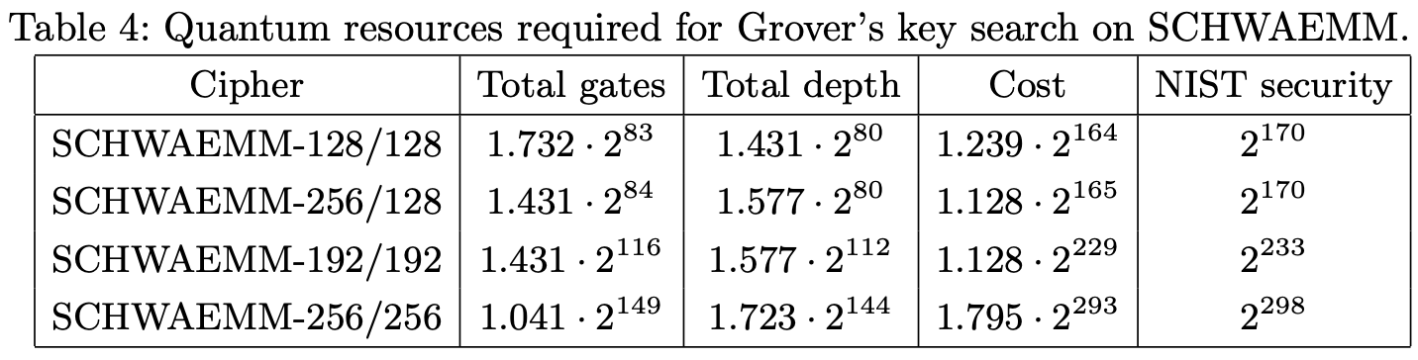
Cost Estimation for Grover Key Search
Table 3: Quantum resources required for Grover’s key search on SCHWAEMM
AES-128
AES-192
AES-256
Attack cost = Total gates X Total depth
[NIST's post-quantum security requirements]
Ciphers should be comparable to or higher than the Grover attack cost for AES
Notes:
This is the part that evaluates the post-quantum security strength based on the estimated resources.
Table three shows quantum resources required for Grover’s key search on SCHWAEMM.
Grover key search attack cost is the product of Total gates and Total depth.
NIST security in table3 is post-quantum security requirements provided by NIST.
According to this, ciphers should be comparable to or higher than the Grover attack cost for AES

Slide 16
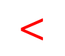
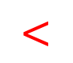
Cost Estimation for Grover Key Search
Table 3: Quantum resources required for Grover’s key search on SCHWAEMM
$$<$$
$$<$$
AES-128
$$<$$
AES-192
$$<$$
AES-256
Attack is possible with fewer quantum resources
⇒ Appropriate security level cannot be achieved
SCHWAEMM is exposed to attack at a lower cost than AES with same key size.
Notes:
Attack is possible with fewer quantum resources, so appropriate security level cannot be achieved.
Therefore, SCHWAEMM can be exposed to attack at a lower cost than AES with same key size.

Slide 17
Cost Estimation for Grover Key Search
<Table 3> NIST security
AES attack cost estimated by NIST is the result of 2016
If the results of significantly reducing the quantum attack cost are presented, the estimated cost in post-quantum security requirements should be conservatively evaluated.
Recently, Implementations for optimizing quantum circuits for AES have been proposed.
Compared with the attack cost for Jaques et al’s AES estimated, SCHWAEMM achieves an appropriate.
Notes:
However, AES attack cost of table3 is the result of 2016 provided by Grassl.
This circuit is not implemented by optimizing AES as a quantum circuit.
According to NIST, if the results of significantly reducing the quantum attack cost are presented, the estimated cost in post-quantum security requirements should be “conservatively” evaluated.
Recently, Implementations for optimizing quantum circuits for AES have been proposed.
Among them, compared with the attack cost for Jaques et al’s AES estimated, SCHWAEMM achieves an appropriate security level according to the key size.

Slide 18
Conclusion
Conclusion
Our implementation has been optimized by applying various techniques to minimize the cost
Focused on reducing the depth complexity as well as the qubit complexity.
Future work
Analyzing the cost of Grover’s attack for other final candidate algorithms of NIST LWC
Evaluating the post-quantum security strength for other final candidate algorithms of NIST LWC
Notes:
In conclusion, our implementation has been optimized by applying various techniques to minimize the cost. And we focused on reducing depth complexity as well as the qubit complexity. for example, if we use a few qubits and can save a large number of depth, we choose to allocate more qubits and reduce the depth.
Let's talk about future work, we will Analyze the cost of Grover’s attack for other final candidate algorithms of NIST LWC, and evaluate the post-quantum security strength for other final candidate algorithms of NIST LWC.

Slide 19
yujin.yang34@gmail.com
Notes:
Thank you for listening.
Do you have any question?
I'm not good at English, so if possible, I want answer this questions by email. Please understand this. If you have any questions, please send me by this email. I’d be pleased to answer them.
Thank you for listening.

